Slide 1

Project 3 Presentation
Time Series Analysis of Covid and Flu in Australia

Slide 2
Topic : The Effect of covid 19 and the spread of influenza on local population within Australia and find relationship between Flu and Covid 19 Spreading Behaviour.
Presented By;
Mark Stephen
Alam Parvez
Wilfred Andoh
Kaushal Patel

Slide 3
Data Sources
Flu Data: From National Notifiable Diseases-Surveillance System’s public-dataset.
Covid 19 Data: https://www.covid19data.com.au/

Slide 4
Introduction
The purpose of the project is to use data analytic tools to reveal the effect of covid 19 and the spread of influenza within the Australian population. Our data is based on six years flu data (2015-2021) and a two year Covid19 data (2019-2021)
Show interactive map of Covid 19 and Flu Cases in Australia by State during this period.

Slide 5
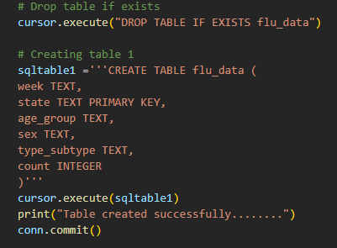
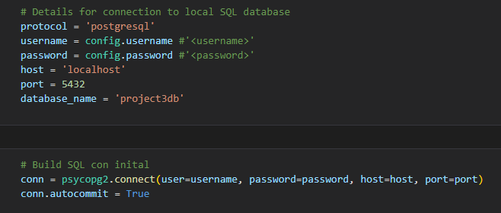
Data Cleaning and Storage Pandas, Python, Postgres tools were used for cleaning the data
Presented by Mark Stephen

Slide 6
Data Visualisation
Presented by Parvez ALam

Slide 7
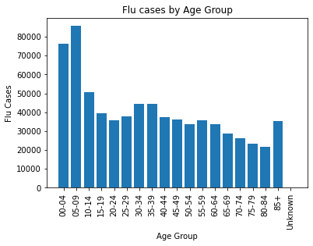
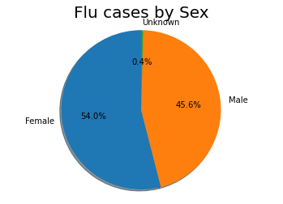
Influenza /Flu Visualisation

Slide 8
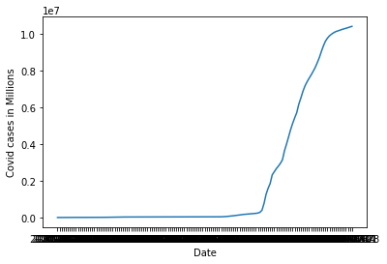
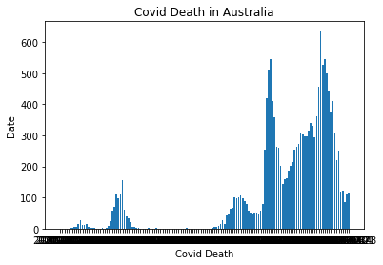
Covid Visualisation.

Slide 9
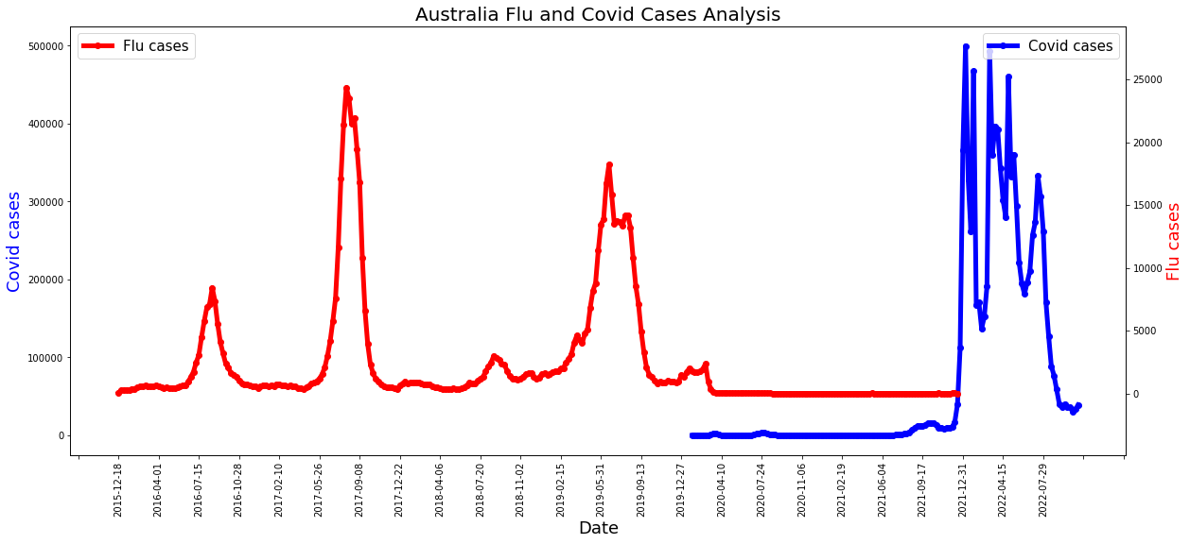
What is the correlation between Covid19 and Influenza?

Slide 10
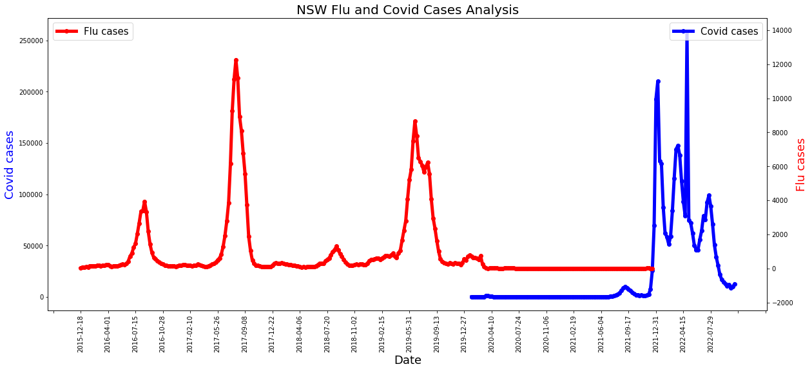
State wise Correlation NSW

Slide 11
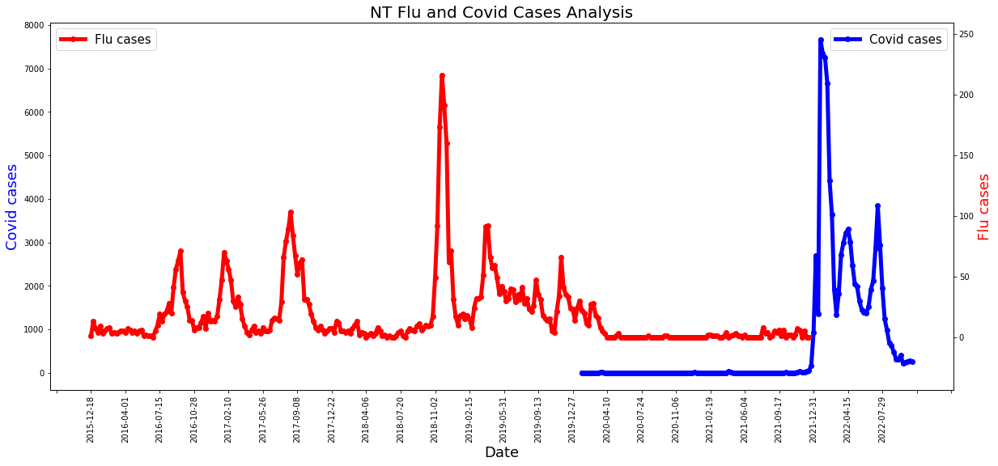
State wise Correlation NT

Slide 12
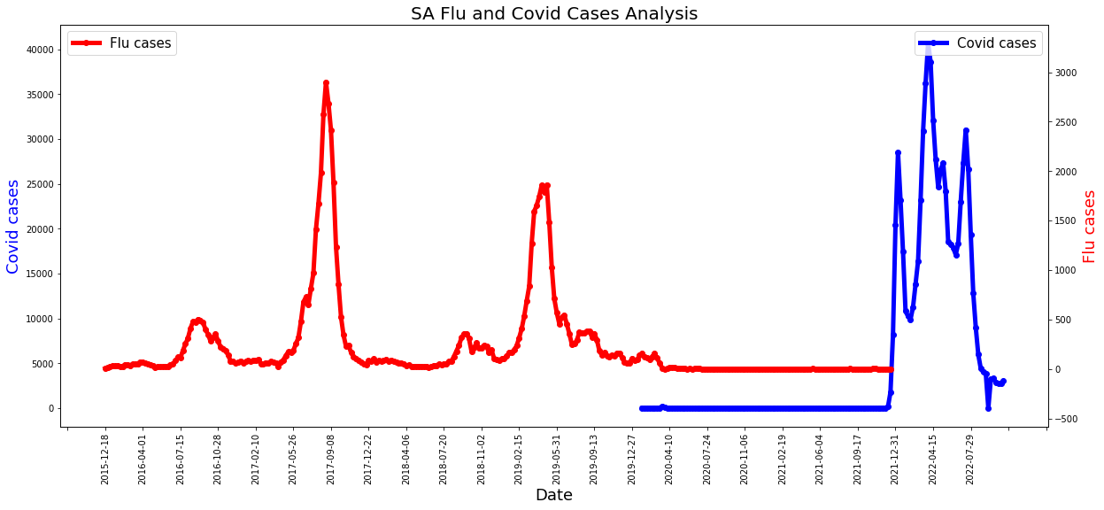
State wise Correlation SA

Slide 13

Interactive Maps
Presented by Kaushal Patel

Slide 14
Conclusion
In conclusion whilst we were unable to visualize the data as we would have like on our web page, we did find the following.
Initial data shows that in Australia the start of Covid 19 infections and the safety measures that were subsequently brought in shows an immediate drop in Flu cases.
This is shown in all states and is consistent across the timelines of Covid 19.
It is reasonable to assume that the safety measures that were implemented for Covid 19 directly suppressed Flu cases in Australia. It will be interesting to monitor this over the coming years to see if this continues or we start to see a rise in Flu cases as we return to normal life.
Thanks for Listening

